Slide 1
All-Stars
Analytics
NCAA Basketball Analysis
Anna Farley, Wendy Guan, Jack Kinkead,
Joanna Kwok, Pravah Malunjkar, Shane O’Brien
Notes:
Joanna

Slide 2
Objectives
Introduction
Data and Cleaning
Industry Background Research
Understanding Dataset and Cleaning for Analysis
Data Analysis and Modeling
Data Interpretations
Data Exploration and Stats
Regression Model
Recommendations to Maryland Terps
Notes:
Joanna

Slide 3
Introduction
Background
Sport analysis increasing prevalence
Player performance, improve strategies, predict game outcomes
Players, sports organizations, sponsors, fans
Dataset
Division I college basketball seasons
2013 to 2023
Statistics on basketball game
Business Problems
What leagues are performing best overall?
How are specific basketball stats correlated with wins?
How has performance factors changed pre and post COVID?
What is Maryland Basketball’s impact in the Power 5?
Modeling winning percentage of Maryland Basketball.
Notes:
Joanna

Slide 4
Dataset Variables
Team Info
TEAM
CONF
G
Offense Stats
ADJOE
EFG_O
TOR
ORB
FTR
2P_O
3P_O
ADJ_T
Defense Stats
ADJDE
EFG_D
TORD
DRB
FTRD
2P_D
3P_D
Results
W
POSTSEASON
YEAR
Notes:
Jack

Slide 5
Data Cleaning
1
2
3
4
Interpretation
Consolidation
Deletion
Addition
Understanding what all attributes mean and provide
Creating a single data file with all years of data
Removing categories, such as WAB, that were not considered crucial
Adding the year column in order to parse dates
Notes:
Jack

Slide 6


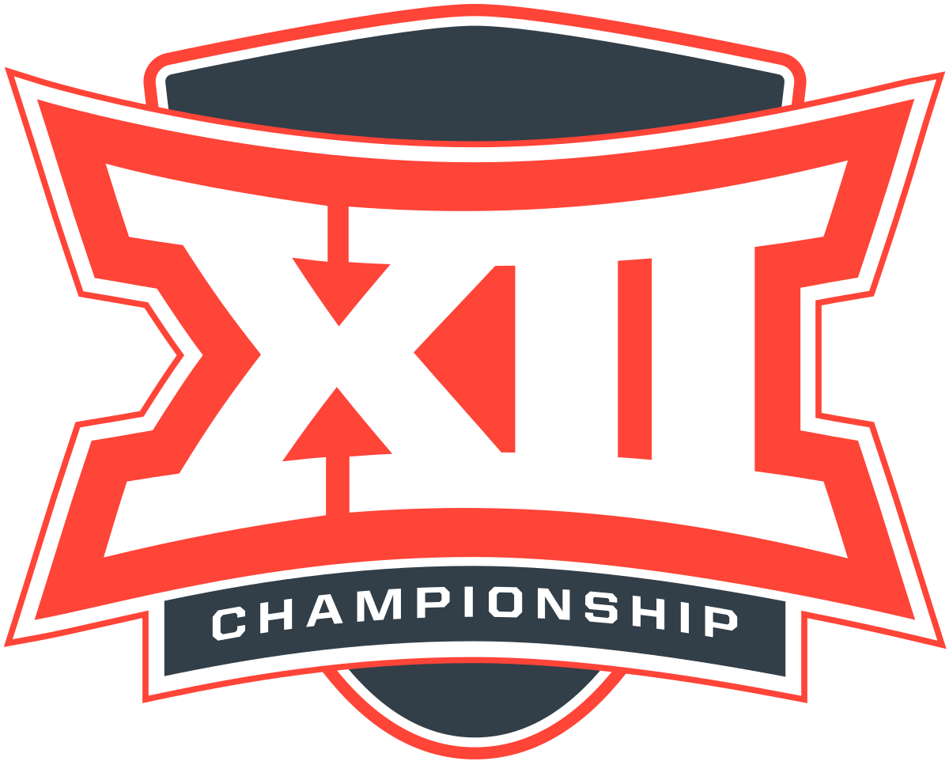


Power 5 Conferences
SEC
B10
Southeastern Conference
Big Ten
B12
PAC-12
Big Twelve
Pacific-12 Conference
ACC
Atlantic Coast Conference
Notes:
wendy

Slide 7
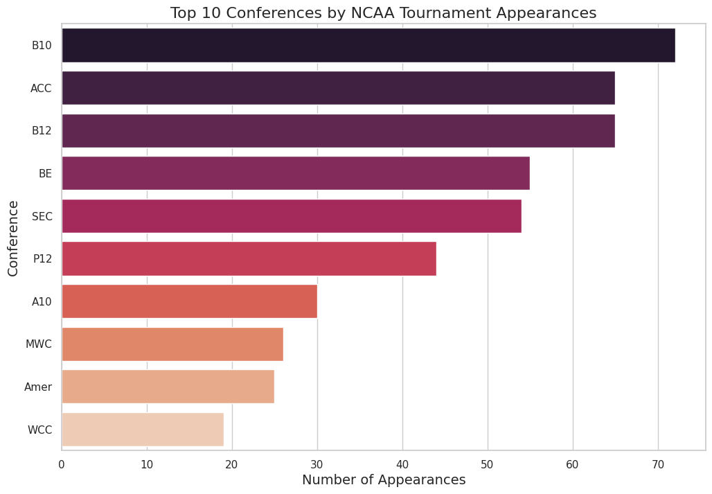
Why consider Power 5 conferences as high competition?
Appearances in NCAA Tournament (March Madness)
What is Power 5?
5 most prominent and influential conferences in college football
Top ⅚ are Power 5
The top ⅚ conferences that has the most NCAA Tournament Appearances are Power 5 schools
Notes:
Wendy

Slide 8
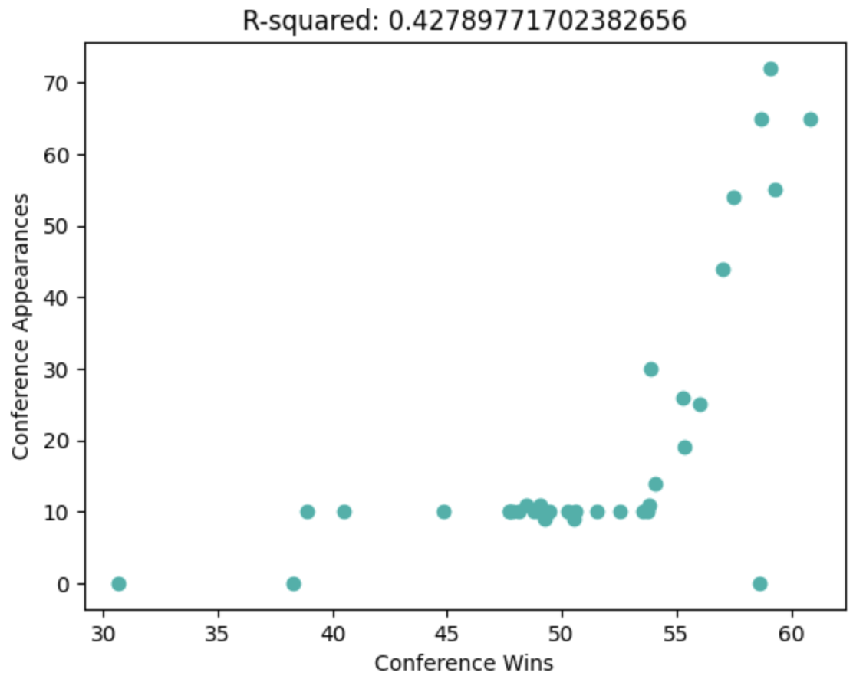
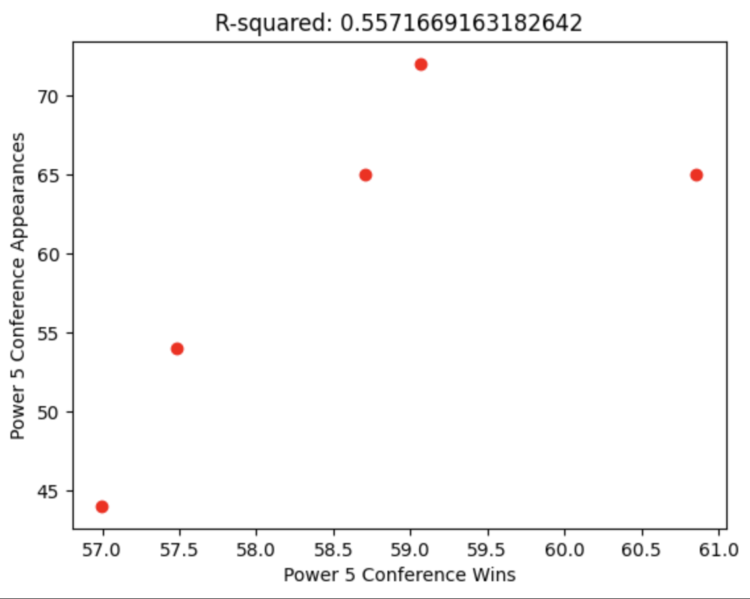
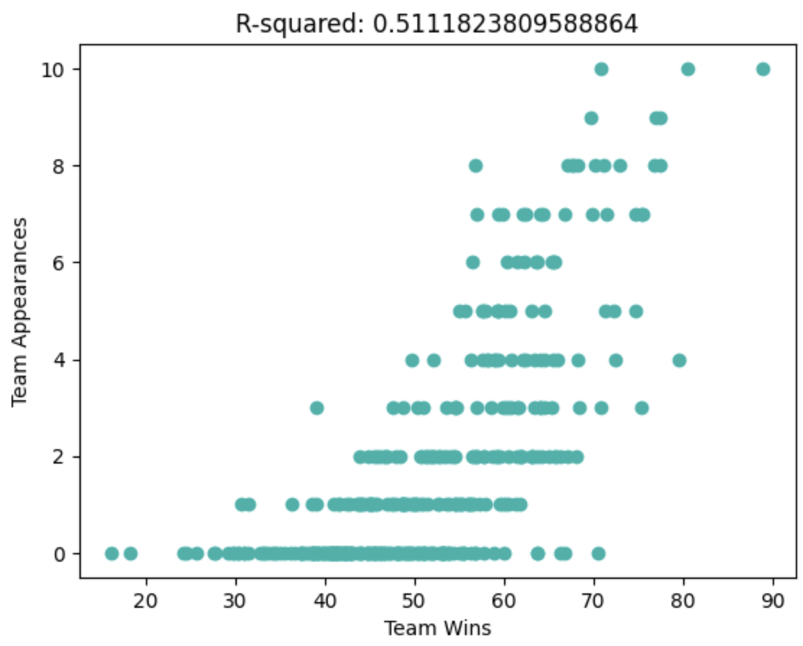
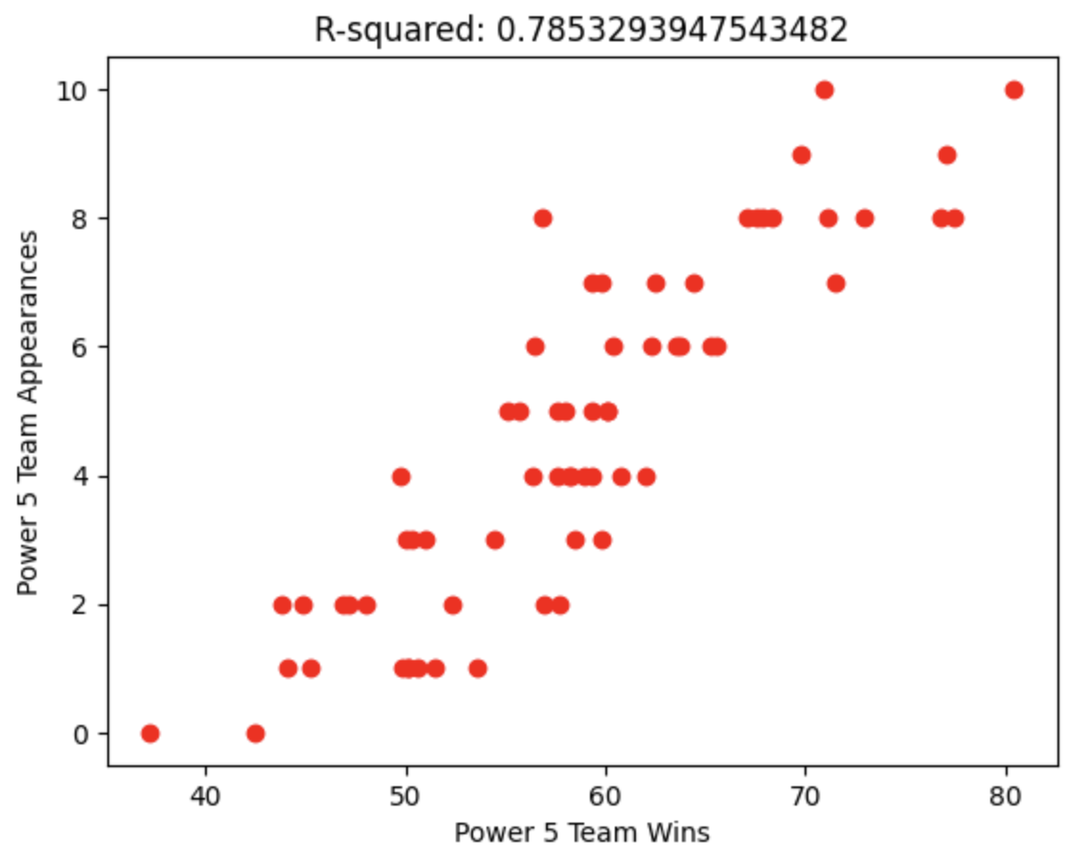
Data Limitations - Competitiveness by Conference
vs.
All Conferences
Power 5
Win percentage v March Madness Appearances
Notes:
Jack

Slide 9
Exploratory Data Analysis
Offensive Win Rate
Conference-wise Distribution
Wins vs. Adjusted Offensive Efficiency
Adjusted Defensive Efficiency Comparison
Covid Factor
Correlated Factors
Has Covid affected teams’ overall?
Heatmap correlation matrix
Notes:
Pravah

Slide 10
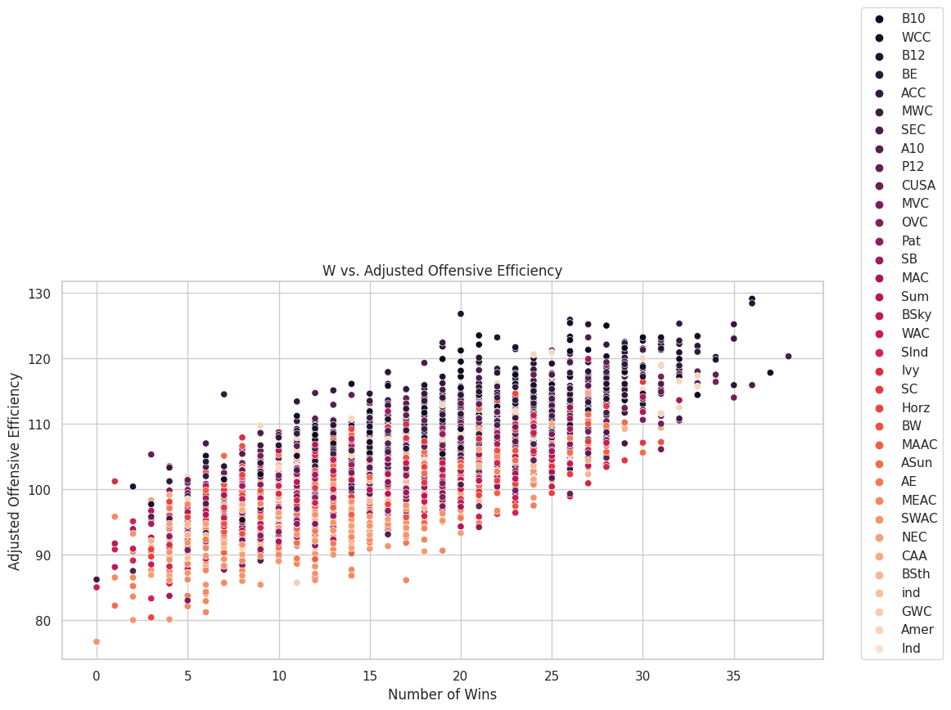
Conference-wise Wins vs. Adjusted Offensive Efficiency
Teams of Power 5 Leagues manage to maintain a high ADJOE
Other leagues (eg. Ivy, NEC, GWC) do not show a high ADJOE to high win correlation.
Directly affects possession to points rate in determining league superiority.
Notes:
Pravah

Slide 11
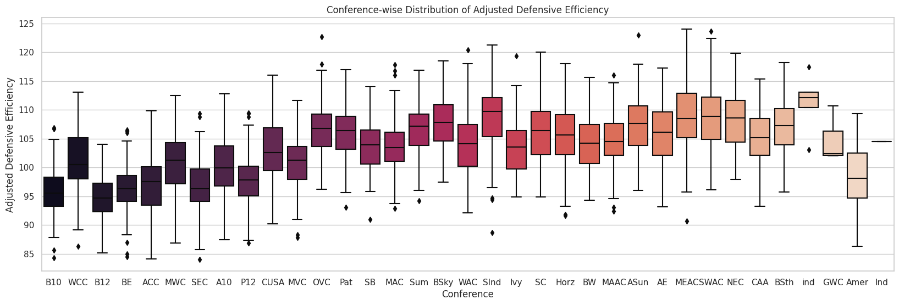
Conference-wise Distribution of Adjusted Defensive Efficiency
On the other hand the Power 5 represent a lower ADJDE.
Leagues like WAC and Sind have some of the highest ADJDE
Whilst the rest of the leagues have skewed distributions with outliers.
Notes:
Pravah

Slide 12
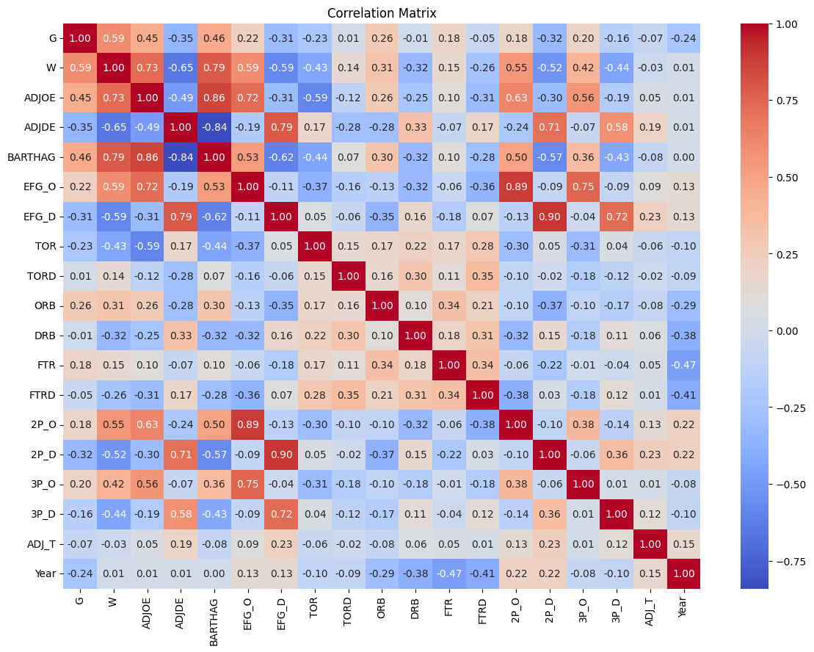
Correlated Factors with Respect to Wins
As seen in the heatmap we can see that most leagues’ stats are dependent on the Offensive Efficiency over the Defensive Efficiency.
We can also see that successful 2-point shots (0.55) have a better impact on the win rate than successful 3-point shots (0.42).
The strong correlation between BARTHAG (0.79) and wins suggests that teams that are more likely to beat an average Division I team are also more likely to win more games.
Notes:
Pravah

Slide 13
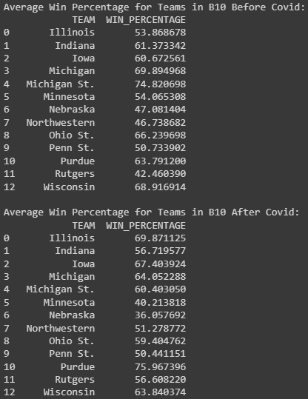
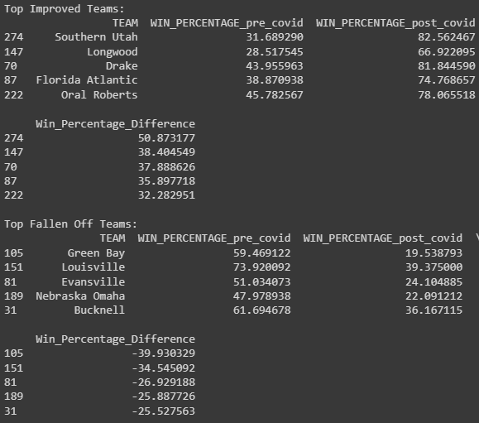
Covid Win Rates vs. Maryland
Notes:
Pravah

Slide 14
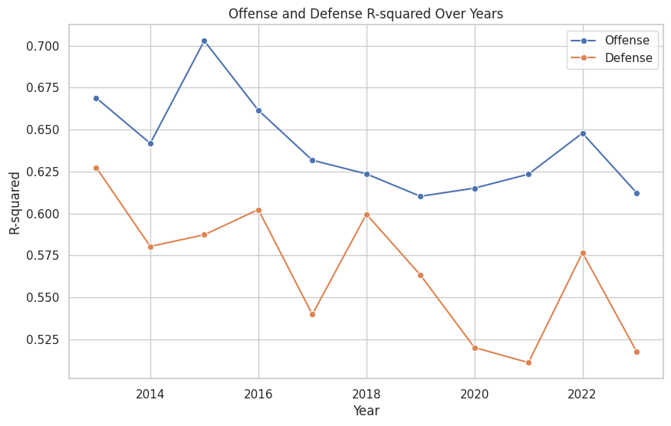
Factors that Contribute to Winning
Is offense or defense more important?
Dependent Variable
Winning Percentage
Independent Variables
Variables separated by offense and defense
Linear Regression Model
Win Percentage vs Offensive Variables
Win Percentage vs Defensive Variables
Model with offensive variables has higher R squared throughout the years
Notes:
Wendy

Slide 15
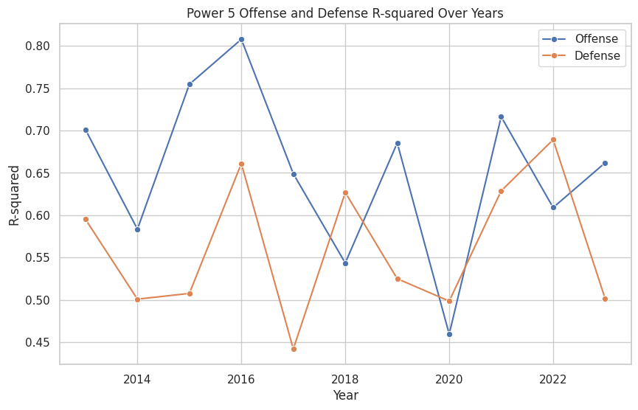
Is this still true modeled for Power 5 conferences?
Similar to Overall until 2017
Offensive model has a better fit
Post 2017
Changes year by year
For strong competition
Power 5 conferences have more similarity in their statistics
Less data points compared to the overall model
Notes:
Wendy

Slide 16
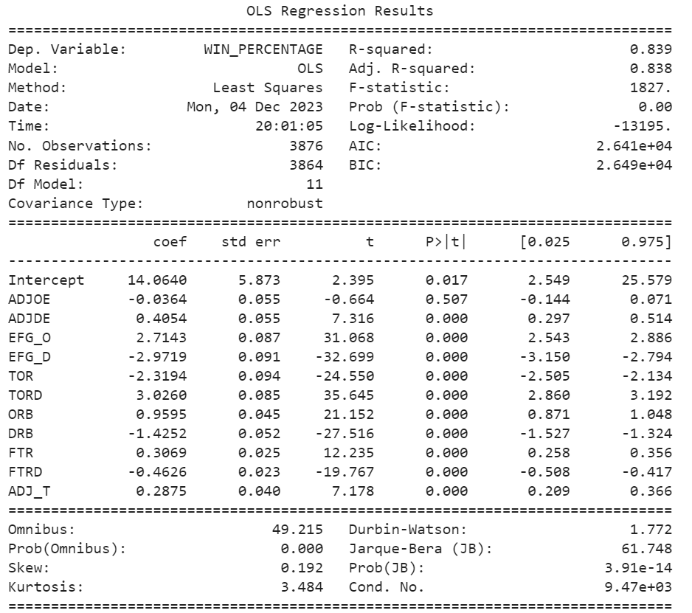
OLS Model 1 - All Data
Key Notes
Model 1 utilizes all independent variables as defined by our cleaned dataset to predict ‘WIN_PERCENTAGE’
R² = 0.839
ADJOE has a non-significant p-value, indicating a lack of significant predictive power
Notes:
Anna

Slide 17
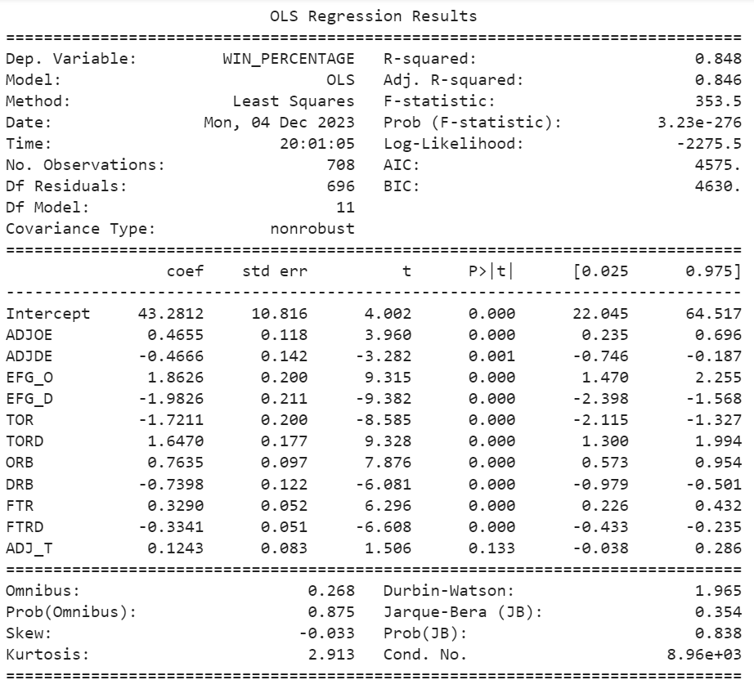
OLS Model 1 - Adjusted for Power 5 Conferences
Key Notes
Model 1 utilizes all independent variables as defined by our cleaned dataset to predict ‘WIN_PERCENTAGE’
R² = 0.848
Greater than Model 1, Why?
Only ADJ_T has non-significant p-value
Notes:
The Power 5 basketball teams may represent a more homogenous or distinct subset of the data compared to all conferences. The model may perform better when focusing on a specific group rather than trying to generalize across all conferences where there may be more outliers, leading to a higher adjusted R-squared.

Slide 18
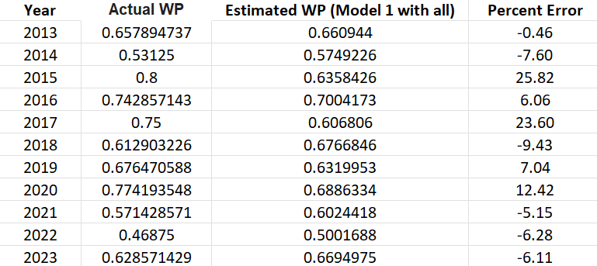
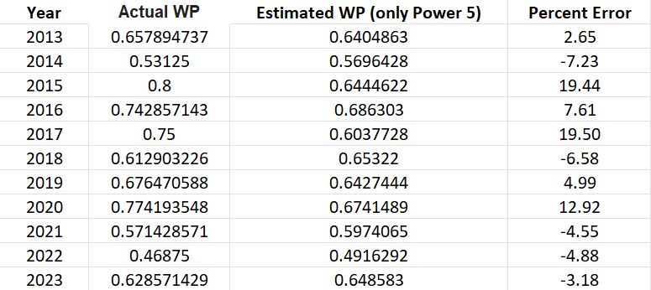
Using Models to Estimate Maryland’s Win Percentage
All Conferences Model
Power 5 Only Model
Average percent error = 3.63
Better Model overall for predicting Maryland
Average percent error = 3.70
Notes:
Anna

Slide 19
Key Insights
1 | 2 | 3 | 4 | 5 | 6
March Madness - All | March Madness - Power 5 | Offense vs Defense - All | Offense vs Defense - Power 5 | Regression - All vs Power 5 | Regression Nuance
Win percentage does not correlate linearly with tournament appearance | Win percentage appears to be linearly related to tournament appearance | Offense consistently predicts win% better than defense | Superior predictive power varies from year to year | All factor model has better predictive power for the Power 5 | All conference model better predicts UMD win%
Notes:
Shane
Selection process for march madness pick the best 36 teams overall
The top 5 basketball teams may represent a more homogenous or distinct subset of the data compared to all conferences. The model may perform better when focusing on a specific group rather than trying to generalize across all conferences, leading to a higher adjusted R-squared.
Maryland's performance is influenced by factors that extend beyond the typical patterns seen in Power 5 teams, a model trained on all conferences might capture those nuances better.

Slide 20
Thank You!

Slide 21
References
Sundberg, A. (2023, July 7). College basketball dataset. Kaggle. https://www.kaggle.com/datasets/andrewsundberg/college-basketball-dataset/data?select=cbb.csv

